Slide 1
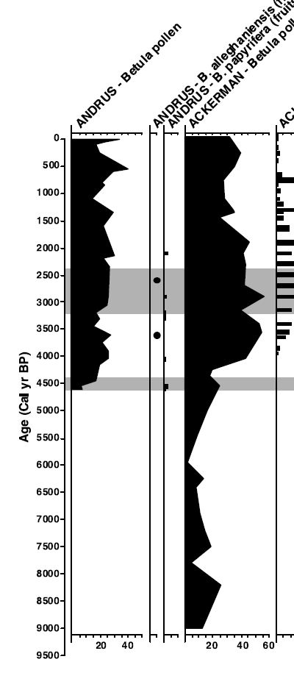
Dating and Age Model Uncertainty
For geologists, time is an unknown variable. It must be estimated. It has uncertainty.
Critical evaluation of age estimates and age models is fundamental to good inference in the paleogeosciences.
Increasingly, time uncertainty is blended into uncertainty of paleoecological & paleoclimatic inferences
Timing of Yellow Birch expansion
– Jackson & Booth 2002

Slide 2
Dating and age model uncertainty
Part I: Radiocarbon Dating: Fundamentals
Part II: Time: Concepts & Informatics
Part III: Classical Age Models & clam
Part IV: Bayesian Age-Depth Models & bacon

Slide 3
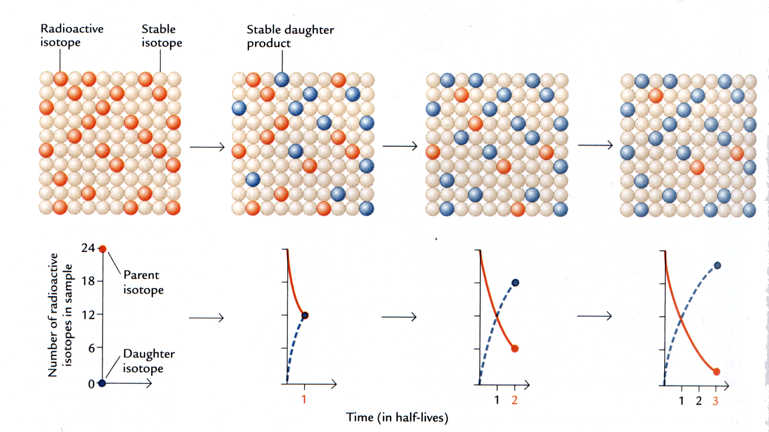
Principles of Radiometric Dating
Unstable isotopes decay exponentially
Each isotope has its own, fixed, rate constant (λ)
N_{t}=N₀e^{-λt}
t_{1/2} = (ln 2)/λ
N= Number of radioactive isotopes remaining at time T
N₀= Number of radioactive isotopes at start
λ= decay constant
t= time elapsed
t_{1/2}= half-life of substance
Ruddiman 2.9

Slide 4
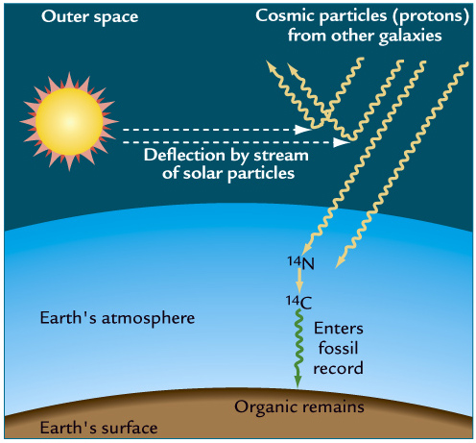
Principles of Radiocarbon dating
Carbon has three isotopes: two stable, one unstable:
¹²C : 98.89% of all C
¹³C : 1.11% of all C
¹⁴C : 0.0000000001% of all C
Radiocarbon produced by cosmic bombardment of atmospheric ¹⁴N
Carbon taken up by all living (organic) things via photosynthesis or their food
On death, organisms cease to take in ¹⁴C
In the dead material, as time goes by, ¹⁴C decays, produces ¹⁴N, which escapes to atmosphere
Ruddiman 14.15
Modified text from slide by Maarten Blaauw

Slide 5
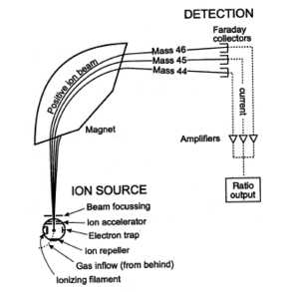
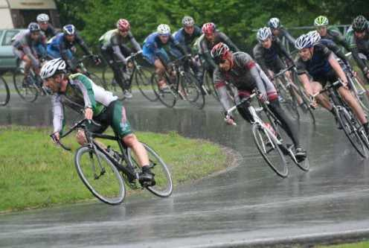
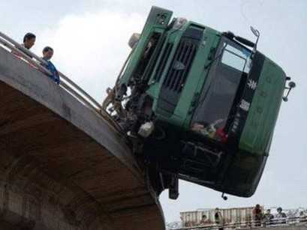
Measuring Radiocarbon: Accelerator Mass Spectrometry
¹²C
¹⁴C

Slide 6
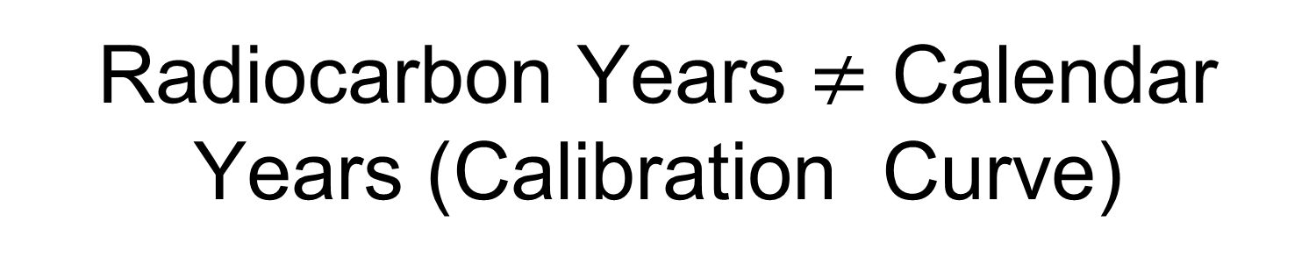
Radiocarbon Years $≠$ Calendar Years (Calibration Curve)
Lambda is a
constant (we think)
We measure N_{t} (¹⁴C
remaining) in our sample
N_{t}=N₀e^{-λt}
We want to
estimate time
N₀ is unknown!
Radiocarbon ages assume that N₀ is constant over time, i.e. the amount of ¹⁴C in the atmosphere is unchanged. This assumption is untrue.

Slide 7
Why ¹⁴C_{atm} is not constant
Both the production and removal of ¹⁴C to/from the atmosphere varies over time
Atmospheric production
Ocean/Vegetation/Atm C exchange
Hence, the amount of ¹⁴C in the atmosphere varies over time.
Hence N₀ varies, and is uncertain.
Ruddiman 14.15

Slide 8
We use Calibration Curves to estimate calendar age from ¹⁴C ages
Convert by dating many materials of known age.
Tree rings, varved sediments, corals, speleothems, …
Non-linear (wiggly)
Divergence increases with age

Slide 9
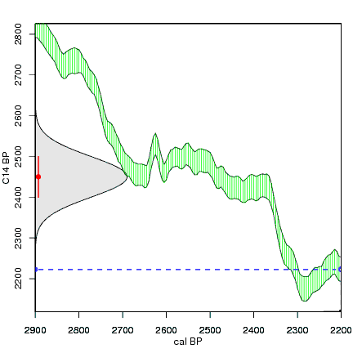
Wiggles in the Calibration Curve produce highly irregular age estimates
Original ¹⁴C
age estimate with a Student T distribution
‘Plateau’
… this has spurred development of age models that can handle these irregular uncertainty distributions
Resultant (highly irregular)
calendar age estimate
http:///www.chrono.qub.ac.uk/blaauw/

Slide 10
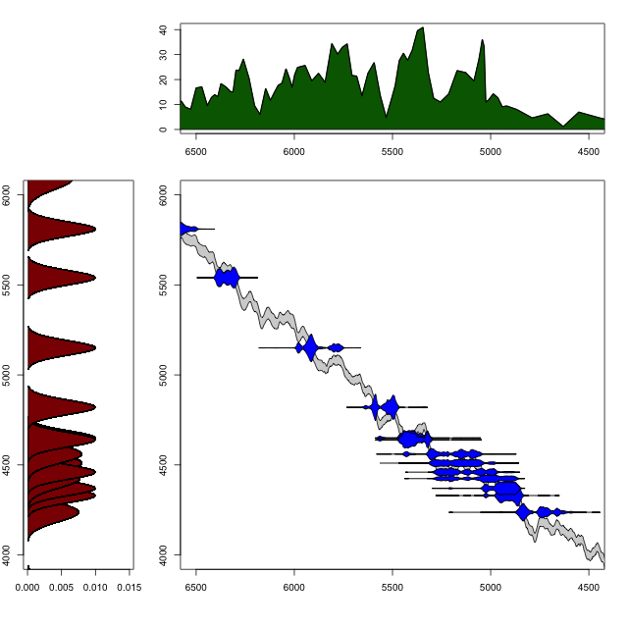
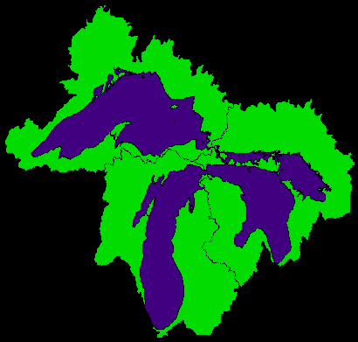
Using Wiggle-Matching to your Advantage:
Timing and Synchrony of the Tsuga Decline at Irwin Smith Bog
Tsuga pollen %
Best estimate:
5050 yr BP
¹⁴C dates
¹⁴C-years Before Present
Calendar-years Before Present
R.K. Booth, S. Brewer, M. Blaauw, T.A. Minckley & S.T. Jackson, 2012. Ecology.

Slide 11
Marine Reservoir Effect: systematic offset between true age and ¹⁴C age in marine materials
CO₂
Air
Surface Ocean
PSN
CO₂
orgC
Deep Ocean
CO₂
Caused by mixing of ‘old’ carbon up from deep ocean
On the order of hundreds of years to over 1000 years

Slide 12
Dating and age model uncertainty
Part I: Radiocarbon Dating: Fundamentals
Part II: Time: Concepts & Informatics
Part III: Classical Age Models & clam
Part IV: Bayesian Age-Depth Models & bacon

Slide 13
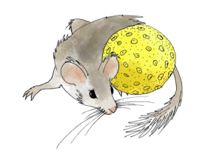
Time in Neotoma: Key Concepts
The Neotoma data model for time is based on three related concepts
Age Controls
Age-Depth Models
Chronologies
Age
Controls
Age-Depth Models
Chronologies
Williams, Grimm et al. 2018 QR
Grimm et al. 2014 Age Models, Chronologies, and Databases Workshop. PAGES Workshop Report.

Slide 14
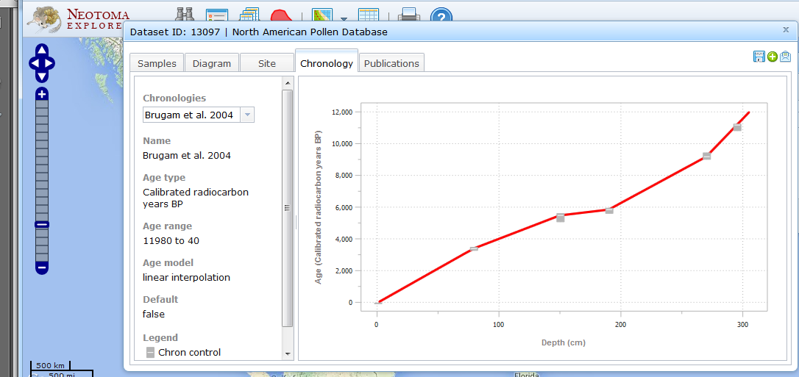
Terminology
Age Control: an estimate of absolute age, often with a specified uncertainty, for a sample within a core or stratigraphic profile that is used to constrain an age model.
Glimmerglass Lake
Williams, Grimm et al. 2018 QR
Grimm et al. 2014 Age Models, Chronologies, and Databases Workshop. PAGES Workshop Report.

Slide 15
Terminology
Age-Depth Model: an algorithm used to estimate the age-depth relationship for a series of stratified paleoenvironmental data points. Used to estimate ages for depths not associated with an age control or to resolve discrepancies among age controls.
Glimmerglass Lake
Williams, Grimm et al. 2018 QR
Grimm et al. 2014 Age Models, Chronologies, and Databases Workshop. PAGES Workshop Report.

Slide 16
Terminology
Chronology: the series of estimated ages for a set of samples in a collection unit, linked to a particular combination of age controls and age-depth model
Depth (cm) | Age (yr BP)
10 | 240
20 | 355
30 | 480
40 | 640
50 | 1020
60 | 1400
70 | 1890
Glimmerglass Lake
Williams, Grimm et al. 2018 QR
Grimm et al. 2014 Age Models, Chronologies, and Databases Workshop. PAGES Workshop Report.

Slide 17
Terminology
Relative Ages: ages based on sample association with recognized stratigraphic units or geologic events
Age Scales Currently Stored Internally by Neotoma
Geologic Timescale
Geomagnetic Polarity Timescale
Marine Isotopic Stages
Heinrich Stadials
Quaternary Event Classification
North American Archaeology Timescale
North American Land Mammal Ages
South American Land Mammal Ages
Williams, Grimm et al. 2018 QR
Grimm et al. 2014 Age Models, Chronologies, and Databases Workshop. PAGES Workshop Report.

Slide 18
Neotoma uses the Geochronology table to store absolute age controls
Geochronology
GeochronTypes
GeochronD
SampleID
GeochronTypeID
AgeTypeID
Age
ErrorOlder
ErrorYounger
Infinite
Delta13C
LabNumber
MaterialDated
Notes
GeochronTypeID
GeochronType
Amino acid racemization
Carbon-14
Cosmogenic
Electron spin resonance
Fission track
Potassium-argon
Optically stimulated luminescence
Lead-210
Silicon-32
Thermoluminescence
Uranium series
Carbon-14: accelerator mass spectrometry
Carbon-14: proportional gas counting
Carbon-14: liquid scintillation
Carbon-14: conventional radiometric
Argon-argon
Protactinium-231
Archaeomagnetic
Obsidian hydration
Paleomagnetic
Dendrochronological

Slide 19
Age-depth models and chronologies: stored in ChronControls and Chronologies Tables
CollectionUnits
Chronologies
ChronControls
CollectionUnitID
SiteID
CollTypeID
DepEnvtID
Handle
CollUnitName
CollDate
CollDevice
GPSLatitude
GPSLongitude
GPSError
WaterDepth
Location
Notes
ChronologyID
CollectionUnitID
AgeTypeID
ContactID
IsDefault
ChronologyName
DatePrepared
AgeModel
AgeBoundYounger
AgeBoundOlder
Notes
ChronControlID
ChronologyID
ChronControlTypeID
Depth
Thickness
Age
AgeLimitYounger
AgeLimitOlder
Notes
In Neotoma, ChronControls stores the age controls used in an age model. Chronologies stores the age model metadata

Slide 20
Relative Ages & Chronologies
RelativeChronology
RelativeAges
RelativeAgeScale
RelativeChronID
AnalysisUnitID
RelativeAgeID
Notes
RelativeAgeID
RelativeAgeUnitID
RelativeAgeScaleID
Relative Age
C14AgeYounger
C14AgeOlder
CalAgeYounger
CalAgeOlder
Notes
RelativeAgeScaleID
RelativeAgeScale

Slide 21
Dating and age model uncertainty
Part I: Radiocarbon Dating: Fundamentals
Part II: Time: Concepts & Informatics
Part III: Classical Age Models & clam
Part IV: Bayesian Age-Depth Models & bacon

Slide 22
Age-depth models
Goal:
Age estimates for all depths in a core with uncertainty
Need to accommodate:
irregular uncertainty distributions for individual age controls
Variations in sedimentation rate, including hiatuses & rapid sedimentation events
Outlier dates and biased dates

Slide 23
‘Classical’ Age Models: Common Variants
Linear Interpolation (connect the dots)
Regression
Linear Regression: t = b₀+b₁*d
Polynomial Regression t = b₀+b₁*d+… b_{n}d_{n}
Splines (must pass through all knots with minimum bends)
Cubic Spline
Smooth Spline
Locally Weighted Spline (LOWESS)

Slide 24
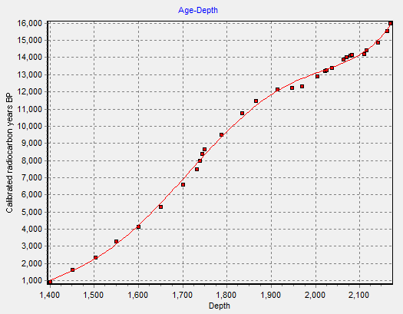
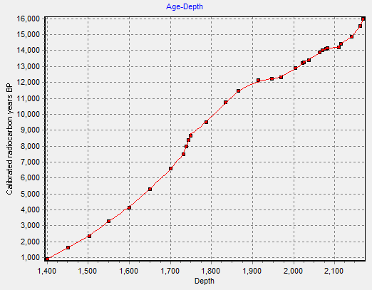
Classical Age Models
5th-Degree Polynomial
Cubic B-spline

Slide 25
Classical Age Models & Uncertainty
Classical age models do not treat uncertainty very well.
Most treat age controls as point estimates & do not handle irregular probability distributions (clam does)
Fitted models do not accommodate local uncertainties due to few dates, conflicting dates, etc.
Most paleo-papers do not formally incorporate age uncertainty into analyses.

Slide 26

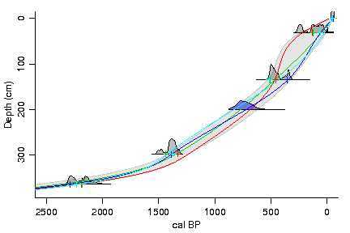
CLAM: Good option for classical age models
R software
available from Blaauw’s website
R package at https://github.com/SimonGoring/clam
Internally calibrates ¹⁴C dates, using latest IntCal
User selects model type (linear interpolation, spline, regression)
Repeatedly samples from calibrated ¹⁴C to fit multiple curves, better estimates of uncertainty
Images: Maarten Blaauw

Slide 27
Dating and age model uncertainty
Part I: Radiocarbon Dating: Fundamentals
Part II: Time: Concepts & Informatics
Part III: Classical Age Models & clam
Part IV: Bayesian Age-Depth Models & bacon

Slide 28
Bayesian Age Models
Combine new information (age controls) with prior information
Major Priors include:
Stratigraphic Superposition: Deeper sediments are older (Steno’s Law)
Sediment accumulation rate
Sediment ‘Memory’ (i.e. the autocorrelation or variability between depths)
Hiatuses
Output: Probabilistic estimates of age given priors and age controls

Slide 29
A quick list of Bayesian Age Models
MexCal: Christen, 1994. PhD thesis Nottingham
BCal: Buck et al., 1999. Internet Archaeology 7
Best for discrete horizons (e.g. top and bottom age estimates for a archeo-cultural horizon)
OxCal: Bronk Ramsey, 2008. QSR 27:42-60
Widely used
Bpeat: Blaauw & Christen, 2005. Appl Stat 54: 805-816
Superseded by bacon
Bacon: Blaauw & Christen, 2011. Bayesian Anal 6: 1-18
Widely used.
Bchron: Parnell et al. 2008 QSR 27: 1872-1885
Widely used

Slide 30
Bacon
Divides a core into n cm-thick sections
Models accumulation for each section (with separate parameters for each section)
MCMC for parameter estimation
Priors for:
Accumulation rate
Sediment memory
Hiatus locations
Outlier age controls identified using Student T distribution
Can calculate probability of synchrony of events between sites

Slide 31
Bacon example – Spicer Lake, IN
MCMC Chain
Green=Prior
Gray=Posterior
Notice higher uncertainty when no data
15 AMS dates + core top
Some charcoal dates with very small sample sizes apparently too young
Wang et al. 2015 Holocene.

Slide 32
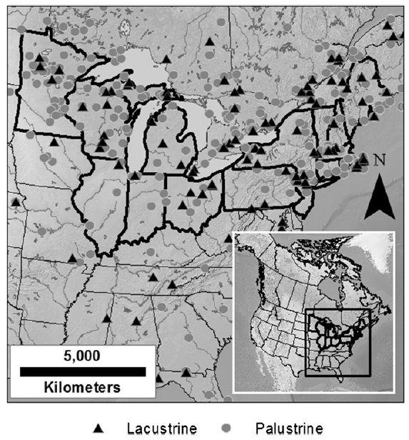
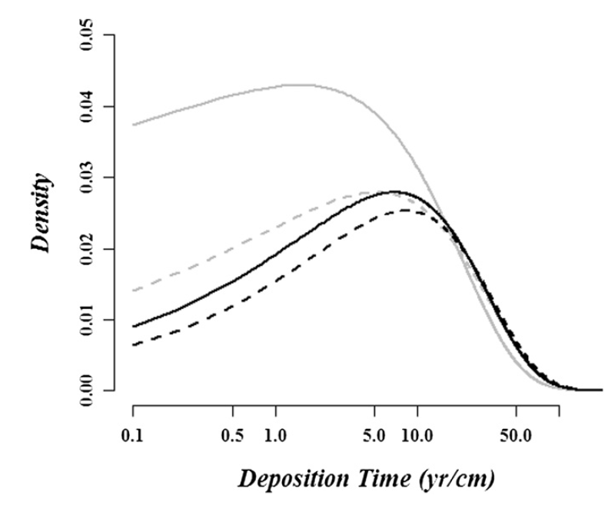
Setting Priors in Bacon
Sediment Accumulation Rate: See Goring et al 2012
Sediment memory - Bacon uses a fairly non-informative prior
Hiatuses: use your judgment
Also: Number of Sections.
Not a prior – determines # of sections.
More sections allow more flexibility in age-depth curve, too many will impose high computational costs
Gamma Distributions
Goring et al. 2012

Slide 33
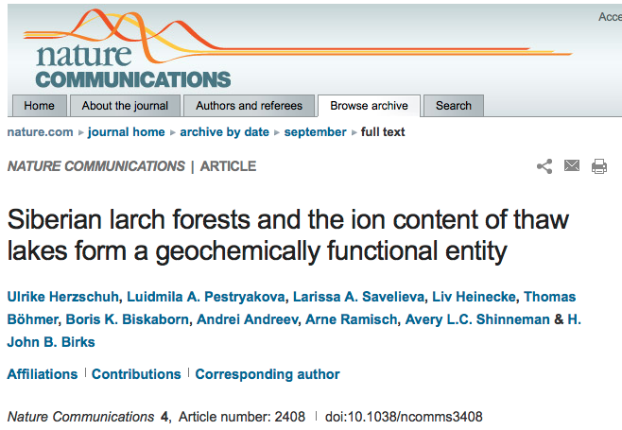
Good models do not substitute for good judgment
“We used the BACON software³⁸ on twelve ¹⁴C dates to construct a robust age-depth model (for details, see Supplementary Note 1). The reliability of the inferred ages from the lower part is supported by an almost similar age-depth model generated from the extrapolation of the mean sedimentation rate inferred from ²¹⁰Pb dating of the upper part of the core.”
Example from Blaauw

Slide 34
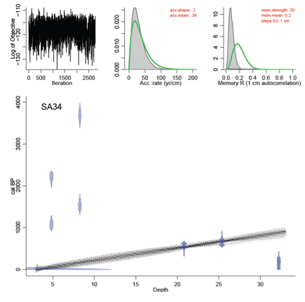
Example from Blaauw

Slide 35
Lab 3 Exercise
Calibrating Radiocarbon Dates: CALIB & clam
Classical Age-Depth models (clam)
Bayesian Age-Depth Models (bacon)

Slide 38
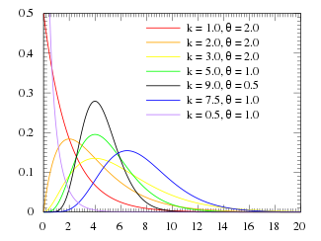
Gamma Distributions
α=k
β=1/θ
Highly flexible
Range: zero to unbounded
Two parameters: α & β (shape & rate)
https://en.wikipedia.org/wiki/Gamma_distribution

Slide 39
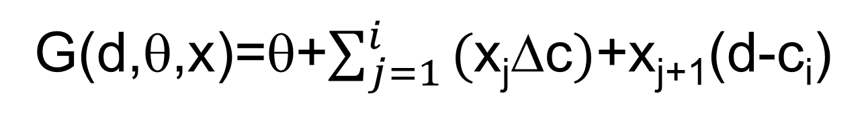
The Bacon Model (Part 1)
Depth to Calendar Age Model (G)
G(d,θ,x)=θ+$\sum_{j=1}^{i}{\text{(}\text{x}\text{j}\text{D}\text{c})}$+x_{j+1}(d-c_{i})
where:
d=depth of radiocarbon sample
c_{i}=uniformly separated depth intervals
Δc=depth interval
x_{j}=sediment accumulation rate for section j
θ=intercept
Sediment rates (x) modeled as a Gamma autoregressive model
Radiocarbon ages (y) modeled as Student T distributions

Slide 40
The Bacon Model (Part 2)
Radiocarbon to Calendar Age Model (μ)
E[y_{j}|d_{j},x]=μ(G(d_{j},θ,x))
where:
y=radiocarbon ages
d=depth of radiocarbon sample
x_{j}=sediment accumulation rate for section j
θ=intercept
Sediment rates (x) modeled as a Gamma autoregressive model
Radiocarbon ages (y) modeled as Student T distributions

